Slide 1

ngular
Copyright 2018-2020 Funny Ant LLC

Slide 2
npm QuickStart
Node.js package manager
Notes:
The Node.js package manager makes it easy for JavaScript developers to share and reuse code, and it makes it easy to update the code that you're sharing.
It's a way to reuse code from other developers, and also a way to share your code with them, and it makes it easy to manage the different versions of code.
Reference:
https://www.npmjs.com/

Slide 3
Installing Dependencies
Package manager
Notes:
If you've been working with Javascript for awhile, you might have heard of npm: npm makes it easy for Javascript developers to share the code that they've created to solve particular problems and for other developers to reuse that code in their own applications.
Once you're depending on this code from other developers, npm makes it really easy to check to see if they've made any updates to it and to download those updates when they're made.
These bits of reusable code are called packages, or sometimes modules. A package is just a directory with one or more files in it that also has a file called "package.json" with some meta data about this package. A typical application, such as a website, will depend on dozens or hundreds of packages.
These packages are often small. The general idea is that you create a small building block which solves one problem and solves it well. This makes it possible for you to compose larger, custom solutions out of these small, shared building blocks.
Reference: https://docs.npmjs.com/getting-started/what-is-npm

Slide 4
Global Installs
$ npm install typescript --global //-g for short
Notes:
This command installs a package and any packages that it depends on.
If the package has a shrinkwrap file the installation of dependencies will be driven by that file.
Reference:
https://docs.npmjs.com/cli/install

Slide 5
Global Packages Location
$ npm get prefix
Mac:
/Users/[username]/.npm-packages/lib/node_modules
PC:
%AppData%\npm\node_modules (Windows 7)
%USERPROFILE%\Application Data\npm\node_modules (Windows XP)

Slide 6
Local Installs
$ npm init –y #creates package.json –y uses defaults
$ npm install typescript --save-dev #saves in package.json
#creates node_modules directory
$ tsc -v #fails because can't find package
$ node_modules/.bin/tsc -v #outputs version info
Notes:
This will ask you a bunch of questions, and then write a package.json for you.
It attempts to make reasonable guesses about what you want things to be set to, and then writes a package.json file with the options you've selected.
If you invoke it with -f, --force, -y, or --yes, it will use only defaults and not prompt you for any options.
Reference:
https://docs.npmjs.com/cli/init

Slide 7
package.json dependencies and devDependencies
$ npm install rxjs --save
$ npm install typescript --save-dev
{ "name": "npm-quickstart", "version": "1.0.0", "description": "", "main": "index.js", "scripts": {}, "keywords": [], "author": "", "license": "ISC", "dependencies": { "rxjs": "^5.2.0" } }
{ "name": "npm-quickstart", "version": "1.0.0", "description": "", "main": "index.js", "scripts": {}, "keywords": [], "author": "", "license": "ISC", "dependencies": { ”rxjs": ”5.2.0" }, "devDependencies": { ”typescript": "^2.2.1" } }
Notes:
The dependencies property in the package.json file is for modules (libraries) that need to be included in your production deployment.
Dependencies are installed with the --save command line argument to npm.
The devDepencies property in the package.json file is for modules (libraries) that are only needed as part of the development/build process.
Development dependencies are installed with the --save-dev command line argument to npm.

Slide 8
Semantic Versioning
Major.Minor.Patch
If you were starting with a package 1.0.4, this is how you would specify the ranges:
Patch releases: ~1.0.4
Minor releases: ^1.0.4
Major releases: * or x | 1.0.4 → 2.0.0
Notes:
Major: *, Minor: ^, Patch: ~
If a project is going to be shared with others, it should start at 1.0.0
After this, changes should be handled as follows:
Bug fixes and other minor changes: Patch release, increment the last number, e.g. 1.0.1
New features which don't break existing features: Minor release, increment the middle number, e.g. 1.1.0
Changes which break backwards compatibility: Major release, increment the first number, e.g. 2.0.0
^1.2.3 which keeps major version compatibility. It’s equivalent to >= 1.2.3, < 2.0.0. This is useful when you need to support an API version.
~1.2.3 is to support patch level only changes. It’s equivalent to >= 1.2.3, < 1.3.0. This allows for bug fixes without the addition of new features.
1.2.3 - 3.4.5 is a range where anything within that range is allowed. It’s a shortened syntax for >= 1.2.3, <= 3.4.5.
To better understand play with the semantic versioning calculator: https://semver.npmjs.com/
Reference: https://docs.npmjs.com/getting-started/semantic-versioning

Slide 9
Sharing Dependencies
$ npm install //installs dependencies and devDependencies
$ npm install --production //installs dependencies only
Notes:
Often you will want to share your project’s source code with team members collaborating with you or open source contributors or users of the code.
The npm install command with no other arguments makes it easy for others to quickly get your project setup. They make a copy of the project (often by cloning a git rep) and run the npm install command to install all the project’s dependencies listed in the package.json file.
The npm install command can also be used to help install the necessary dependencies on a computer used to host the application after deployment (testing, staging and production environments).
With the --production flag (or when the NODE_ENV environment variable is set to production), npm will not install modules listed in devDependencies.

Slide 10
Updating Dependencies
$ npm update lite-server -g //update a global dependency
$ npm update rxjs --save //update a local dependency
Notes:
This command will update all the packages listed to the latest version (specified by the tag config), respecting semver.
Reference: https://docs.npmjs.com/cli/update

Slide 11
Uninstalling Dependencies
$ npm uninstall lite-server -g //uninstall a global dependency
$ npm uninstall rxjs --save //uninstall a local dependency
Notes:
This uninstalls a package, completely removing everything npm installed on its behalf.
Reference: https://docs.npmjs.com/cli/uninstall

Slide 12
npm Review
Take 2 minutes to write down your answers to the following questions on a piece of paper.
npm is essentially the JavaScript language’s package manager
Name at least one package manager that is used for a different language?
If you aren’t familiar with any other package managers feel free to use the internet to search for the name of the package manager for a programming language.
Write down the following two column headings on a piece of paper as show below.
dependencies | devDependencies
List these packages under the heading you would most commonly use them.
Jasmine (Unit Testing)
Bootstrap (CSS framework)
http-server (development web server)
TypeScript (compiles code to JavaScript that will be run in the browser)

Slide 13
Lab Node Package Manager (npm)
Open TypeScriptLabManual.pdf and follow the directions to do the following sections:
Create Project
Install TypeScript & RxJS

Slide 14
Understanding package-lock.json
In an ideal world, the same package.json should produce the exact same node_modules tree, at any time
In some cases, this is indeed true. But in many others, npm is unable to do this
To reliably produce the exact node_modules tree, package-lock.json was created.
Notes:
References:
https://docs.npmjs.com/files/package-locks
https://medium.com/coinmonks/everything-you-wanted-to-know-about-package-lock-json-b81911aa8ab8

Slide 15
Broken package.json scenarios
Different versions of npm (or other package managers) may have been used to install a package, each using slightly different installation algorithms.
A new version of a direct semver-range package may have been published since the last time your packages were installed, and thus a newer version will be used.
A dependency of one of your dependencies may have published a new version, which will update even if you used pinned dependency specifiers (1.2.3 instead of ^1.2.3)
The registry you installed from is no longer available, or allows mutation of versions (unlike the primary npm registry), and a different version of a package exists under the same version number now.
Notes:
References:
https://docs.npmjs.com/files/package-locks

Slide 16
Using npm as a Build Tool
Build Automation | npm scripts
Notes:
npm's scripts directive can do everything that these build tools can, more succinctly, more elegantly, with less package dependencies and less maintenance overhead.
Reference: https://docs.npmjs.com/misc/scripts

Slide 17
What about Grunt and Gulp?
npm's scripts directive can do everything that these build tools can, more succinctly, more elegantly, with less package dependencies and less maintenance overhead
What’s Wrong with Gulp and Grunt?
Complexity
Dependence on plugin authors
Frustrating debugging
Disjointed documentation
Notes:
Reference: http://blog.keithcirkel.co.uk/how-to-use-npm-as-a-build-tool/
Reference: https://medium.freecodecamp.com/why-i-left-gulp-and-grunt-for-npm-scripts-3d6853dd22b8#.s5fgosjkw

Slide 18
Your First Script
$ npm init -y //creates package.json
{ "name": "npmscriptsdemo", "version": "1.0.0", "description": "", "main": "index.js", "scripts": { "test": "echo \"Error: no test specified\" && exit 1", "hi": "echo hello world " }, "keywords": [], "author": "", "license": "ISC" }
$ npm run-script hi //hello world
Custom npm script
Run the custom script

Slide 19
Shortcuts
Instead of:
$ npm run-script [script-name]
You could use the shorter:
$ npm run [script-name]
Or if it’s one of the npm supported scripts you can omit the run command:
$ npm [script-name]
Notes:
Supported scripts are built-in to npm and can be run without the run command.
See list on next slide.
Reference: https://docs.npmjs.com/misc/scripts

Slide 20
Supported Scripts
prepublish: Run BEFORE the package is published. (Also run on local npm install without any arguments.)
publish, postpublish: Run AFTER the package is published.
preinstall: Run BEFORE the package is installed
install, postinstall: Run AFTER the package is installed.
preuninstall, uninstall: Run BEFORE the package is uninstalled.
postuninstall: Run AFTER the package is uninstalled.
preversion, version: Run BEFORE bump the package version.
postversion: Run AFTER bump the package version.
pretest, test, posttest: Run by the npm test command.
prestop, stop, poststop: Run by the npm stop command.
prestart, start, poststart: Run by the npm start command.
prerestart, restart, postrestart: Run by the npm restart command.
Note: npm restart will run the stop and start scripts if no restart script is provided.
Notes:
The most commonly used are start, stop, test, and install.
We’ll see an example of how postinstall is used in our Angular project’s package.json.
Reference: https://docs.npmjs.com/misc/scripts

Slide 21
Running Local Node Modules
$ npm init #creates package.json
$ npm install typescript --save-dev #saves in package.json
#creates node_modules directory
$ tsc -v #fails because can't find package
$ node_modules/.bin/tsc -v #returns version
//package.json snippet
"scripts": { ”tsc": ”tsc" }
$ npm run tsc -- -v #returns version but path not required in package.json

Slide 22
Combining Scripts package.json
&& can be used to combine scripts
{ "name": "project-manage", "version": "1.0.0", "scripts": { "start": "tsc && concurrently \"npm run tsc:w\" \"npm run lite\" ", "lite": "lite-server", "postinstall": "typings install", "tsc": "tsc", "tsc:w": "tsc -w", "typings": "typings" },
Notes:
The logical operator && can be used to combine scripts as shown above.
Concurrently is a node module that allows us to run multiple command concurrently.
After TypeScript and other node modules have been installed using npm, install the postinstall command can then run to install typescript definitions for the modules used.
Reference: https://www.npmjs.com/package/concurrently

Slide 23
TypeScript/ES2015
Introduction

Slide 24
TypeScript
Notes:
ECMAScript (or ES) is a trademarked scripting-language specification standardized by Ecma International.
JavaScript is a well-known implementation of the language.
Ecma International is an international private (membership-based) non-profit standards organization for information and communication systems.
Originally Ecma stood for European Computer Manufacturers Association (ECMA) but now is just an acronym to reflect it’s global reach.
ES5 is the current version of JavaScript supported in most browsers (IE9+).
ES6 is the next version of JavaScript that was ratified by the standards body June 2015 but is yet to be widely adopted in browsers.
ES6’s official name is now ES2015. It was known previously as JS.Next.
TypeScript is a superset of ES2015/ES6 adding optional types and decorators.
ES5 and ES6 are both valid TypeScript.

Slide 25
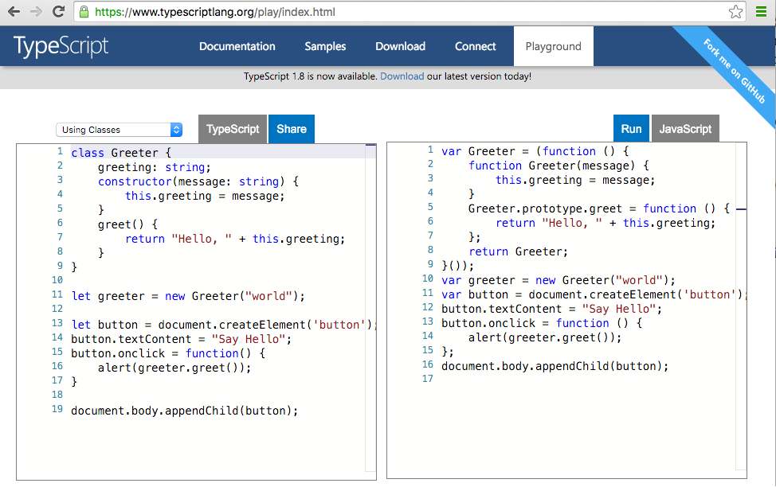
How TypeScript Works
Notes:
TypeScript provides a compiler tsc (TypeScript compiler) that transpiles TypeScript to JavaScript or more specifically ES5.
Transpilation refers to a specific kind of compilation, source code to source code.
We traditionally think about compilers as transforming source code to bytecode.
Remember, ES5 is valid TypeScript.
Visit: typescriptlang.org/play/index.html

Slide 26
Why TypeScript?
TypeScript is a primary language for Angular application development
Angular is written in TypeScript.
Recommended by Angular core team and Google
Types enable better tooling including
Refactoring
Navigating code
Code completion
Decorators (annotations) provide an easily understandable API

Slide 27
Who is Behind TypeScript?
Anders Hejlsberg
Core developer of TypeScript
Microsoft technical fellow
Lead architect C#
Original author Turbo Pascal: Delphi
Image from Wikimedia Commons

Slide 28
Installing TypeScript
Global
npm install -g typescript
Local
npm init //creates package.json
npm install typescript --save-dev //saves version to package.json
//To ensure you’re getting local version run using npm scripts

Slide 29
Configuring TypeScript
tsc --init
message TS6071: Successfully created a tsconfig.json file.
//default tsconfig.json
{ "compilerOptions": { "target": "es5",
... } }

Slide 30
Compiling with TypeScript
tsc
//OR
tsc --watch
Notes:
Looks for files with .ts extension and compiles to JavaScript version indicated in tsconfig.json

Slide 31
JavaScript is valid TypeScript
Q: What would be the output of the following JavaScript code run through the TypeScript compiler?
function greeter(name) { return "Hello " + name; }
console.log(greeter("Anders"));
A: The same code.
Notes:
If you don’t like TypeScript, you can throw away your TypeScript and keep your JavaScript output files.
It has been said that the TypeScript compiler writes better JavaScript than most developers.

Slide 32
Type Annotations
function greeter(name: string) { return "Hello " + name; } console.log(greeter("Anders"));
Notes:
Type annotations in TypeScript are lightweight ways to record the intended contract of the function or variable. In this case we intend the greeter function to be called with a single string parameter.

Slide 33
Lab Node Package Manager (npm) & TypeScript
Open TypeScriptLabManual.pdf and follow the directions to do the following sections:
Run TypeScript
Type Annotations

Slide 34
ES2015 Classes
class Student{ public firstName: string; middleInitial: string; lastName: string; constructor(firstName: string, middleInitial: string, lastName: string){ this.firstName = firstName; this.middleInitial = middleInitial; this.lastName = lastName; } getFullName(){ return this.firstName + " " + this.middleInitial + ". " + this.lastName; } }
Property: public is the default
Public keyword is not required
Constructor
let student = new Student("John", "D", "Rockefeller"); console.log(student.getFullName());
Create instance and invoke method
Notes:
The constructor method is a special method for creating and initializing an object created with a class.
There can only be one special method with the name constructor in a class.
If you do not create a constructor method, one with no arguments will be created for you.
You reference properties in the constructor and other functions with the this prefix.
Methods on classes are instance methods by default and do not require the function keyword (see getFullName above).
Objects or instances of classes are created with the new keyword.

Slide 35
TypeScript Automatic Property Assignment
class Student { firstName: string; middleInitial: string; lastName: string; constructor(firstName, middleInitial, lastName) { this.firstName = firstName; this.middleInitial = middleInitial; this.lastName = lastName; } }
--------------------------------------------------------------------------------------
class Student {
constructor(public firstName:string,
public middleInitial:string,
public lastName:string) {}
}
Equivalent
Notes:
Also of note, the use of public on arguments to the constructor is a shorthand that allows us to automatically create properties with that name.
The top and bottom code blocks are equivalent.

Slide 36
Classes & Interfaces
interface Person { firstName: string; lastName: string; }
Interface
Class that implements interface
class Student implements Person{ fullName: string; constructor(public firstName, public middleInitial, public lastName) { this.fullName = firstName + " " + middleInitial + " " + lastName; } }
Function that takes parameter of the interface type
function greeter(person : Person) { return "Hello, " + person.firstName + " " + person.lastName; }
Create instance of class and invoke method
let student = new Student("Jon", "M.", "Turner"); console.log(greeter(student));
Notes:
ES6/ES2015 classes can implement interfaces.
If it has the needed properties and methods then it works.

Slide 37
Scope: var, let, const
var
Function scope
let
Block scope
const
Block scope
Cannot change or be redeclared

Slide 38
ES2015 Arrow Functions
let evens = [0,2,4,6,8];
//verbose // let odds = evens.forEach(function(v){ // return v+1; // });
//terse let odds = evens.forEach(v => v + 1);
odds.forEach(line=> console.log(line)); //1,3,5,7,9
Notes:
An arrow function expression has a shorter syntax compared to function expressions and lexically binds the this value.
function(){ }
becomes
( ) =>
Remove function keyword, replace with an arrow to the right of the arguments.
If there is only one argument then parens can be ommitted.
If the function is only one line:
curly braces can be ommitted
the return keyword is not necessary

Slide 39
Lab Node Package Manager (npm) & TypeScript
Open TypeScriptLabManual.pdf and follow the directions to do the following sections:
Classes
Scope
Arrow Functions

Slide 40
ES2015 Arrow Functions (this) without an arrow function
var organization={ name: "Avengers", heroes: ["Hulk", "Iron Man", "Captain America"], printHeroes: function() { var self = this;
this.heroes.forEach(function(hero) { console.log(hero + " is a member of the " + self.name + "."); }); }
};
organization.printHeroes()
Capture this into into self variable
this.name is undefined so we have to use self.name
Notes:
We need to capture the “this” reference inside of printHeroes so we can access the name in the anonymous function passed to the forEach method.

Slide 41
ES2015 Arrow Functions (this) with an arrow function
var organization={ name: "Avengers", heroes: ["Hulk", "Iron Man", "Captain America"], printHeroes: function() { this.heroes
.forEach(h => console.log(h + " is a member of the " + this.name + ".")); }
};
organization.printHeroes();
this.name is “Avengers”
Arrow functions don’t create a new function context
Notes:
When using arrow functions, we can still reference “this.name” without “capturing” this into a ”self” variable.

Slide 42
TypeScript Decorators
With the introduction of Classes in ES2015, there now exist certain scenarios that require additional features to support metadata modifying classes and class members. Aspect-Oriented Programming (AOP).
Decorators provide a way to add both annotations and a meta-programming syntax for class declarations and members
Decorators are a stage 1 proposal for JavaScript and are available as an experimental feature of TypeScript
They may change in future releases

Slide 43
TypeScript Decorators: Configuring
{ "compilerOptions": { "module": "commonjs", "target": "es5", "noImplicitAny": false, "sourceMap": false, "experimentalDecorators": true } }
Notes:
To enable experimental support for decorators, you must enable the experimentalDecorators compiler option either on the command line or in your tsconfig.json.

Slide 44
Decorators
function ClassLogger(target: Function) { console.log("The function that created this class is: " + target); } @ClassLogger class Customer { } var customer = new Customer();
Notes:
A Decorator is a special kind of declaration that can be attached to a class declaration, method, accessor, property, or parameter. Decorators use the form @expression, where expression must evaluate to a function that will be called at runtime with information about the decorated declaration.

Slide 45
ES Modules
ES Modules
Notes:
Modules were introduced in ES2015/ES6 specification but are referred to as ES Modules or ECMAScript Modules.
Starting with the ECMAScript 2015, JavaScript has a concept of modules.
TypeScript shares this concept. Modules are executed within their own scope, not in the global scope; this means that variables, functions, classes, etc., declared in a module are not visible outside the module unless they are explicitly exported using one of the export forms.
Conversely, to consume a variable, function, class, interface, etc. exported from a different module, it has to be imported using one of the import forms.
Modules are declarative; the relationships between modules are specified in terms of imports and exports at the file level.
Modules import one another using a module loader.
At runtime the module loader is responsible for locating and executing all dependencies of a module before executing it.
Well-known modules loaders used in JavaScript include:
the CommonJS module loader for Node.js
require.js, Browserify, Webpack, or SystemJS for web applications running in the browser.

Slide 46
ES Modules Explained
An ES6 module is a file containing JS code.
There’s no special module keyword
A module reads like a script except:
ES modules are automatically strict-mode code
You can use import and export in modules
A JavaScript file is a module if it contains the import and/or export keyword
Modules are executed within their own scope, not in the global scope
Note: This feature is not implemented in any browsers natively at this time. It is implemented in by module loaders.

Slide 47
ES Modules Syntax
The export statement is used to export functions, objects or primitives from a given file (or module)
The import statement is used to import functions, objects or primitives that have been exported from an external module, another script, etc.

Slide 48
ES Module Example
//my-module.ts
export function myFunction(){ return "myFunction was run."; }
---------------------------------------------------------------------------
//program.ts import {myFunction} from "./my-module"; console.log(myFunction());
Notes:
A simple example of a module with one function.

Slide 49
ES Module Privacy Example
//my-module.ts
export function myFunction(){ return "myFunction was run."; }
function myPrivateFunction(){ return "myPrivateFunction was run."; }
---------------------------------------------------------------------------
//program.ts import {myFunction, myPrivateFunction} from "./my-module";
//Module has no exported member myPrivateFunction.
Notes:
Module has no exported member myPrivateFunction.

Slide 50
ES Module Exporting export function, object, primitive, and class
//my-module.ts
export function myFunction(){ return "myFunction was run."; }
var myObject = { name: 'I can access myObject\'s name', myMethod: function(){return 'myMethod on myObject is running.';} } export {myObject}
export const myPrimitive = 55;
export class MyClass{ myClassMethod(){ return "myClassMethod on myClass is running." } }
Notes:
This example shows that you can export multiple bits of code from a module (file).
These bits can be functions, objects, primitives or classes.
The next slide shows how to use this module.

Slide 51
ES Module Importing import function, object, primitive, and class
//program.ts
import {myFunction, myObject, myPrimitive, MyClass} from "./my-module";
console.log(myFunction());
console.log(myObject.name);
console.log(myObject.myMethod());
console.log(myPrimitive); let myClass = new MyClass(); console.log(myClass.myClassMethod());
Notes:
This example shows that you can import different code from a module (file).
You can import functions, objects, primitives or classes.
If we are using lots of different code in a module as we did here, we would may want to use this syntax for the import:
import * as myModule from ”./my-module";
If we do exported code will be part of the bundle sent to the browser regardless if it is actually used.

Slide 52
ES2015 Template literals
class Student{ constructor(private firstName: string,
private middleInitial: string,
private lastName: string){} getFullName(){ return ` First: ${this.firstName} Middle: ${this.middleInitial} Last: ${this.lastName}`; }
}
Use backticks `` | NOT single quotes ’’
Notes:
Template literals are another new feature of ES2015/ES6.
They are string literals allowing embedded expressions.
You can use multi-line strings and string interpolation features with them.
They were called "template strings" in prior editions of the ES2015/ES6 specification.
You can see them used in the getFullName method shown above.

Slide 53
Lab TypeScript
Open TypeScriptLabManual.pdf and follow the directions to do the following sections:
Modules
Do the remaining sections in the manual if time permits

Slide 54
Review (optional)
TypeScript

Slide 55
TypeScript Review
Make a quick written list of 4-6 language features that TypeScript or ES6/ES2015 adds to JavaScript (ES5).
Draw a set diagram like the one I showed earlier to show the relationship between ES5, ES6/ES2015, and TypeScript.

Slide 56
Angular Overview
Big Picture

Slide 57
Why Angular
Why would we build our application front-end in JavaScript?
Why would we use a single-page application framework?
What is your current understanding?

Slide 58
Why a single-page application?
The user experience of a desktop or native application
The deployment story of a web application

Slide 59
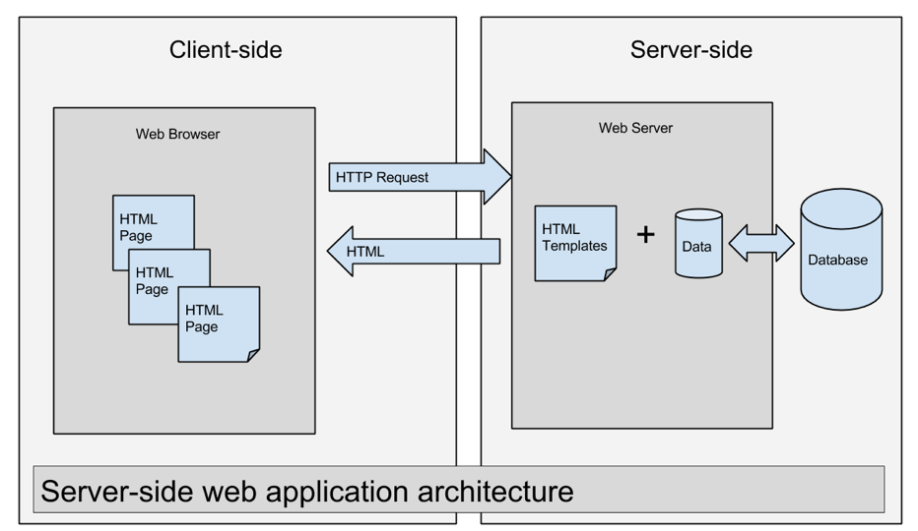
Notes:
Ruby on Rails, Spring(Java), Larvel (PHP), ASP.NET (Microsoft)
Where does the html and the data come together?
In this case, it’s the server (web server).

Slide 60
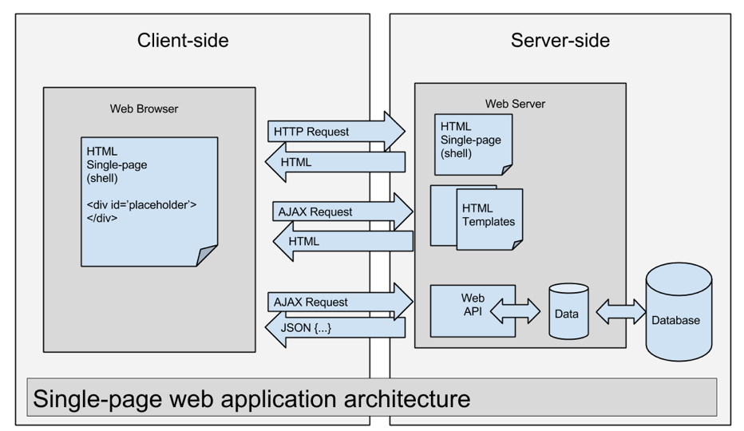
Notes:
Client-side or Single-page web application architecture (Angular, Backbone, React, Ember)
Initial HTTP request for single-page (shell page, often index.html)
AJAX requests for partial page HTML templates
The templates are filled in with data from AJAX requests to a web API (frequently serving JSON)
The resulting markup is then filled in to the placeholder on the shell page

Slide 61
CLIENT
Front-end
JavaScript in browser
NETWORK
(HTTP)
SERVER
Back-end
Web/Application server
Angular
Java
.NET
Node.js
Python
Go
Vert.x
Oracle
MySQL
SQL Server
PostgreSQL
MongoDB
Component
Component
Component
Route
Router
Component
Service
Web API
DB
Route
Model
..
<router-outlet>
</router-outlet>
Model
Model
Templates
<div>
{{ dynamic}}
</div>
app.component.html
<app-root>
</app-root>
Architecture Diagram
index.html
Notes:
UI/Web components are the center of the Angular universe.
These web components are code (component) and html (template).
The html includes Angular and application specific html extensions known as directives.
The template (html) is compiled into JavaScript and combined with the component code.
Angular’s main purpose is take easily understandable, maintainable TypeScript component code and the HTML template and combine it into efficient browser executable JavaScript responsible for rendering part of a web page.
Services used to communicate with a back-end server (commonly via HTTP, AJAX)
Web APIs are implemented in a variety of different technologies.
Router allows you to associate a URL with a particular component(s) and its child components.

Slide 62
Browser Support
Browser | Supported versions
Chrome | latest
Firefox | latest
Edge | 2 most recent major versions
IE | 11 10 9
IE Mobile | 11
Safari | 2 most recent major versions
iOS | 2 most recent major versions
Android | Nougat (7.0) Marshmallow (6.0) Lollipop (5.0, 5.1) KitKat (4.4)
Notes:
In summary, IE9+.
Reference:
https://angular.io/guide/browser-support

Slide 63
Angular Versions
AngularJS
Angular
1.x
angularjs.org
>=2.x
angular.io
Notes:
Use “Angular” for versions 2.0.0 and later (e.g. “I’m an Angular developer”, “This is an Angular meetup”, “The Angular ecosystem is growing quickly”)
Use "AngularJS" to describe versions 1.x or earlier
Use the version number “Angular 4.0” "Angular 2.4" when needed to talk about a specific release (e.g. when talking about a newly introduced feature - “This is an introduction to feature X, introduced in Angular 4”, “I’m proposing this change for Angular 5”)
Use full semver version when reporting a bug (e.g. “This issue is present as of Angular 2.3.1”)
Reference: http://angularjs.blogspot.com/2016/12/ok-let-me-explain-its-going-to-be.html

Slide 64
Style Guide
Follow the official Angular Style Guide
https://angular.io/docs/ts/latest/guide/style-guide.html
Opinionated guide to Angular
Naming
Syntax
Conventions
Application structure

Slide 65
Angular Big Picture Review
With a partner, write down your answers to the following questions on sheet of paper in the next 5 minutes
What site should I visit to get the official documentation on AngularJS?
What site should I visit to get the official documentation on Angular?
In one sentence, why are so many people adopting Angular and other Single-page application frameworks (SPA) frameworks?
Draw a single-page application architecture diagram.
Draw an Angular architecture diagram.

Slide 66
React & Angular Compared
React
Angular
Facebook
Components
Library
Just the View in MVC
Need to include other libraries
React Router (Routing)
Axios (AJAX)
Usually ES6 (Babel compiler)
Create React App
Uses Webpack
Redux
Google
Components
Framework
Modular
Component Router
HttpClient
Forms
Usually TypeScript (tsc compiler)
Angular CLI
Uses Webpack
Reactive Extensions for Angular (ngrx)

Slide 67
React vs. Angular: Key Insights
Angular continues to put “JS” into HTML. React puts “HTML” into JS.
–Cory House
Angular is a more comprehensive library while React is more of a targeted micro library.
Because React is smaller it is:
Easier to understand
Easier to include in a project
React is much more popular (but has existed longer)
React is used more by design/digital/interactive agencies as well as in the Enterprise
Angular is used more for Enterprise software particularly at larger organizations

Slide 68
Project Setup
using the Angular CLI (Command Line Interface)
Notes:
In this section, we will learn about setting up a new Angular project using the Angular CLI (Command line Interface).
Reference: https://cli.angular.io/

Slide 69
Angular Style Guide: Naming Conventions
Symbol Name | File Name
@Component({ ... }) export class AppComponent { } | app.component.ts
@Component({ ... }) export class HeroesComponent { } | heroes.component.ts
@Component({ ... }) export class HeroListComponent { } | hero-list.component.ts
@Component({ ... }) export class HeroDetailComponent { } | hero-detail.component.ts
@NgModule({ ... }) export class AppModule | app.module.ts
@Pipe({ name: 'initCaps' }) export class InitCapsPipe implements PipeTransform { } | init-caps.pipe.ts
@Injectable() export class UserProfileService { } | user-profile.service.ts
Notes:
Reference: https://angular.io/guide/styleguide#symbols-and-file-names

Slide 70
Angular CLI: Features
Create a new Angular application
Run a development server with LiveReload support to preview your application during development
Scaffolds Angular application code
Run your application’s unit tests
Run your application’s end-to-end (E2E) tests
Build your application for deployment to production
Notes:
First 3 bullet points are really helpful but the last 3 are where the CLI will really save you time.
Creating your own build process with Webpack can consume weeks of development time.
Reference: https://github.com/angular/angular-cli/wiki

Slide 71
Creating a New Project
Install the Angular CLI
npm install –g @angular/cli
Create a new project
ng new my-project --routing
cd my-project

Slide 72
Running Your Project
ng serve --open //runs dev server at http://localhost:4200/ and will automatically reload
or
ng serve -o

Slide 73
Angular CLI: Generating Code
Generate a module
ng generate module projects --routing
Generate a component
ng g component projects/project-list
g is short-hand for generate
CLI generates files relative to the app folder
Generated code follows the official Angular Style Guide

Slide 74
Customizing the Angular CLI
Use angular.json to customize
Common CLI customizations including
Asset Configuration
CSS Preprocessors
Global Libraries
Global Scripts
Angular Material
Bootstrap
Font Awesome
Are documented here
https://github.com/angular/angular-cli/wiki/stories

Slide 75
Bootstrapping an Angular Application
Create a root component
By convention named AppComponent
By convention the file is named app.component.ts
Add selector (custom tag) to index.html
Create a root module
By convention named AppModule
By convention the file is named app.module.ts
Declare and bootstrap the root componenent
Import the BrowserModule from Angular
Bootstrap the root module
By convention the file is named main.ts
platformBrowserDynamic
platformBrowser means it will run in a web browser (not a native mobile app etc…)
Dynamic means the template will be compiled in the browser (not on the server)

Slide 76
Demos
Instructor Demonstration
Lab 1: Creating a New Project
Lab 2: Running Your Project
Lab 3: Style: Using a CSS Framework

Slide 77
Labs
Lab 1: Creating a New Project
Lab 2: Running Your Project
Lab 3: Style: Using a CSS Framework
Attendees Hands-On

Slide 78
Components
Angular

Slide 79
CLIENT
Front-end
JavaScript in browser
NETWORK
(HTTP)
SERVER
Back-end
Web/Application server
Angular
Component
Component
Component
Component
Templates
<div>
{{ template}}
</div>
Architecture Diagram:
Components

Slide 80
What is a Component?
A Component controls a patch of screen real estate (view)
Examples of views controlled by components
the shell at the application root with navigation links
the list of projects
the project form
The view is defined using HTML in a template
Component's application logic - what it does to support the view
defined in a class
the class interacts with the view through an API of properties and methods

Slide 81
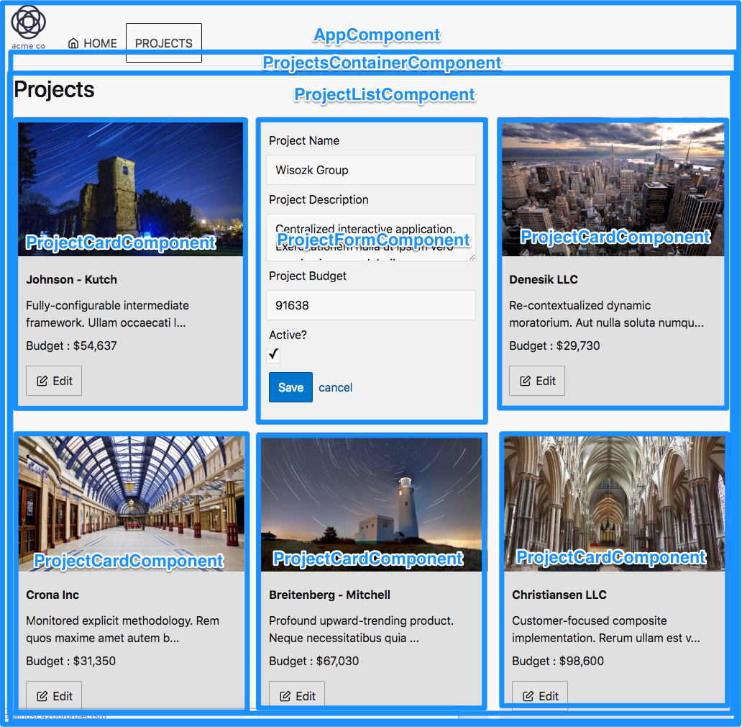
Notes:
This screenshot shows how we could break down our UI into smaller pieces.

Slide 83
Demo: Component Basics
Instructor Only Demonstration
code\demos\component-first
code\demos\component-nesting

Slide 84
Review: Angular Components
Draw a screen of an existing application you work on or are going to work on using Angular (low fidelity)
Now draw boxes around the parts of the screen you would make separate components
No wrong answer at this point, we will go over component architecture throughout the course and revisit the decisions when we have a better understanding

Slide 85
Modules
Angular
NgModule

Slide 86
ES Modules vs Angular Modules
JavaScript (ES) Modules
Angular Modules
ES6 modules represent a single file
JavaScript modules are needed to:
to structure our applications (we cannot use a single file)
to avoid leaking code to the global namespace and thus to avoid naming collisions
to encapsulate code; to hide implementation details and control what gets exposed to the “outside”
to manage dependencies
to reuse code
Angular Modules are an Angular specific construct used to
Logically group different Angular artifacts such as components, services, pipes, and directive
Provide metadata to the Angular compiler which in turn can better “reason about our application” structure and thus introduce optimizations
Lazy load code
Notes:
Reference:
https://juristr.com/blog/2017/03/angular-modules-vs-es6-modules/

Slide 87
Angular Module (NgModule)
Organizes Angular code
Logically groups different Angular framework artifacts such as components, services, pipes, and directive
Similar to packages in Java
Similar to namespaces in .NET
Except Angular Modules are not organizing language constructs, but instead framework constructs

Slide 88
Declarations
@NgModule({
declarations: [
ProjectsContainerComponent,
ProjectListComponent,
ProjectCardComponent,
ProjectFormComponent,
ValidationErrorsComponent,
TruncateStringPipe
]
})
export class ProjectsModule {}
If used in the template of any component listed in this module then they must be listed in declarations.
Angular has it’s own HTML compiler.
It turns Angular HTML templates into JavaScript code that generates dynamic HTML.
The compiler looks for Angular components, directives, and pipes in a template and associates them with your code.

Slide 89
Demo: Module Declarations
Instructor Only Demonstration
code\demos\module-declarations

Slide 90
Feature
Chunk of functionality that delivers business value
Realized by some number of user stories
Often the same as a:
Table in the database
Entity in your domain model

Slide 91
Feature Modules
Feature modules are NgModules for the purpose of organizing code
You can organize code relevant for a specific feature
Helps with collaboration between developers and teams, separating directives, and managing the size of the root module
A feature module is an organizational best practice, as opposed to a concept of the core Angular API
A feature module delivers a cohesive set of functionality focused on a specific application need such as a user workflow, routing, or forms
Collaborates with the root module and with other modules through the services it provides and the components, directives, and pipes that it share
Notes:
Reference:
https://angular.io/guide/feature-modules

Slide 92
Feature Module Example
Imports are always modules and are always named with a Module suffix.
These modules can be parts of the Angular framework, your app’s reusable code, or your app’s other features or routing modules.
@NgModule({
imports: [
ReactiveFormsModule,
CommonModule,
SharedModule,
ProjectsRoutingModule
],
declarations: [
ProjectsContainerComponent,
ProjectListComponent,
ProjectCardComponent,
ProjectFormComponent,
ValidationErrorsComponent
],
providers: [ProjectService]
})
export class ProjectsModule {}
If used in the template of any component listed in this module then they must be listed in declarations.
Services can be registered in providers.

Slide 93
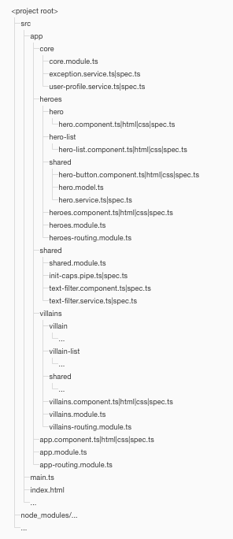
Application Structure
LIFT
Locate code quickly
Identify the code at a glance
Keep the Flattest structure you can
Try to be DRY
Avoid being so DRY that you sacrifice readability
Folders-by-feature
Do create folders named for the feature area they represent.
Notes:
Reference: https://angular.io/guide/styleguide#overall-structural-guidelines

Slide 94
Demo: Module Imports & Exports
Instructor Only Demonstration
code\demos\module-imports-exports

Slide 95
Lab
Lab 4: Your First Component
Attendees Hands-On

Slide 96
Root Module vs Feature Modules
Every Angular app has at least one module, the root module, conventionally named AppModule.
While the root module may be the only module in a small application, most apps have many more feature modules.
A feature module is a cohesive block of code dedicated to an application domain, a workflow, or a closely related set of capabilities.
An Angular module, whether a root or feature, is a class with an @NgModule decorator.
Notes:
Think of Angular modules as a box that you can organize and package different Angular things (components, services, pipes, and directives).
The root module is the junk drawer in your kitchen that is helpful at first but eventually becomes unwieldy as too much unrelated stuff is put into it.
Feature modules are other drawers or storage containers that help you organize the disparate items in the junk drawer into more sensible and manageable collections.
Reference:
https://angular.io/docs/ts/latest/guide/architecture.html#!#modules

Slide 97
Models

Slide 98
CLIENT
Front-end
JavaScript in browser
NETWORK
(HTTP)
SERVER
Back-end
Web/Application server
Angular
Component
Component
Component
Component
Model
Model
Model
Templates
<div>
{{ template}}
</div>
Architecture Diagram: Models

Slide 99
Models are just classes
export class Project {
constructor(
public id: number,
public name: string,
public description: string,
public imageUrl: string,
public contractTypeId: number,
public contractSignedOn: Date,
public budget: number,
public isActive: boolean,
) {}
}
Notes:
Note we are using TypeScript’s auto-property feature so properties are being automatically created.

Slide 100
Models constructor overloads
export class Project {
id: number;
name: string;
description: string;
isActive: boolean;
contractSignedOn: Date;
budget: number;
constructor(obj?: any) {
this.id = (obj && obj.id) || null;
this.name = (obj && obj.name) || null;
this.description = (obj && obj.description) || null;
this.contractTypeId = (obj && obj.contractTypId) || null;
this.isActive = (obj && obj.isActive) || false;
this.contractSignedOn = (obj && obj.contractSignedOn) || new Date();
this.budget = (obj && obj.budget) || 0;
}
}
let project = new Project({ name: 'Acme Website Redesign', budget: 30000 });
Notes:
TypeScript allows you to declare overloads but you can only have one implementation and that implementation must have a signature that is compatible with all overloads.
Reference:
http://stackoverflow.com/questions/12702548/constructor-overload-in-typescript

Slide 101
JSON Pipe
@Component({
selector: 'json-pipe',
template: `<div>
<p>Without JSON pipe:</p>
<pre>{{object}}</pre>
<p>With JSON pipe (no pre tag):</p>
<p>{{object | json}}</p>
<p>With JSON pipe (and pre tag):</p>
<pre>{{object | json}}</pre>
</div>`,
})
export class JsonPipeComponent {
...
}

Slide 102
Angular CLI: Generate Class
ng g class projects/shared/project.model

Slide 103
ngFor
@Component({
selector: 'app-ng-for-demo',
template: `
<ul>
<li *ngFor="let fruit of fruits">
{{fruit}}
</li>
</ul>
`,
})
export class NgForComponent {
fruits = ['Apple', 'Orange', 'Plum'];
}
Start with *
of not in

Slide 104
Demo: ngFor
Instructor Only Demonstration
code\demos\ngFor

Slide 105
Data Binding
Angular
Notes:
In this section we will discuss:
Lifecycle Hooks
Component Communication
Component Styles

Slide 106
Data Binding Four forms (types)
Interpolation
Property binding
Event binding
Two-way data binding
Image from angular.io
Notes:
There are four forms of data binding.
Interpolation is the {{curly braces}}.
Property uses [brackets].
Event binding uses (parenthesis).
Two-way binding is the combination of a property binding and an event binding [(brackets with parenthesis)].

Slide 107
Interpolation
@Component({
selector: 'app-root',
template: `
<h2>{{image.name}}</h2>
<p>{{image.path}} </p>
`,
styles: []
})
export class AppComponent {
image = {
path: '../assets/angular_solidBlack.png',
name: 'Angular Logo'
};
}

Slide 108
Data Binding Four forms (types)
Interpolation
Property binding
Event binding
Two-way data binding
Image from angular.io
Notes:
There are four forms of data binding.
Interpolation is the {{curly braces}}.
Property uses [brackets].
Event binding uses (parenthesis).
Two-way binding is the combination of a property binding and an event binding [(brackets with parenthesis)].

Slide 109
Property Binding
import { Component } from '@angular/core';
@Component({
selector: 'app-root',
template: `
<img [src]="image.path" [title]="image.name"
[alt]="image.name">
`,
})
export class AppComponent {
image = {
path: '../../assets/angularlogo.png',
name: 'Angular Logo',
};
}

Slide 110
Demo: Data Binding Interpolation & Property Binding
Instructor Only Demonstration
code\demos\interpolation
code\demos\property-binding

Slide 111
Input Property
@Input
Decorator that marks a class field as an input property
Property Binding to a Component Property
@Component({
selector: 'app-root',
template: `
<app-fruit-list [fruits]="data"></app-fruit-list>
`,
styles: []
})
export class AppComponent {
data: string[] = ['Apple', 'Orange', 'Plum'];
}

Slide 112
Demo: Input Property
Instructor Only Demonstration
code\demos\input-property

Slide 113
Labs
Lab 5: Creating Data Structures (Models)
Lab 6: Passing Data into a Component
Lab 7: Looping Over Data
Attendees Hands-On

Slide 114
Data Binding Four forms (types)
Interpolation
Property binding
Event binding
Two-way data binding
Image from angular.io
Notes:
There are four forms of data binding.
Interpolation is the {{curly braces}}.
Property uses [brackets].
Event binding uses (parenthesis).
Two-way binding is the combination of a property binding and an event binding [(brackets with parenthesis)].

Slide 115
Event Binding
@Component({
selector: 'app-event-binding-demo',
template: `
<a href="/event-binding" (click)="onClick($event)">Click Me!</a>
<p [innerText]="message"></p>
`,
})
export class EventBindingComponent {
message = '';
onClick(event) {
event.preventDefault();
this.message = 'clicked';
}
}
$event is template variable available in Angular
Can use any standard browser event.
https://developer.mozilla.org/en-US/docs/Web/Events#Standard_events
Prevents the default browser behavior for that element.
https://developer.mozilla.org/en-US/docs/Web/API/Event/preventDefault

Slide 116
Demo: Event Binding
Instructor Only Demonstration
code\demos\event-binding

Slide 117
Pipes
Angular
Notes:
In this section we will discuss:
Lifecycle Hooks
Component Communication
Component Styles

Slide 118
CLIENT
Front-end
JavaScript in browser
NETWORK
(HTTP)
SERVER
Back-end
Web/Application server
Angular
Component
Component
Component
Component
Templates
<div>
{{ template}}
</div>
Architecture Diagram: Templates

Slide 119
What are Pipes?
A pipe takes in data as input and transforms it to a desired output
Commonly used to format data
Get their name from the pipe operator “|”
Can format various types: String, Number, Data, Array
Notes:
In AngularJS pipes were called filters.

Slide 120
Using Pipes
Pipes can be used
In HTML templates
In JavaScript (often in components)
Pipes can be
Built-in to Angular
Custom pipes created by application developers
Custom pipes can be used to implement any type of formatting

Slide 121
Changes from AngularJS
Filters in AngularJS are Pipes in Angular
The “filter” filter is not built-in Angular
Was used to filter out arrays based on a search term
The “orderBy” filter is not built-in to Angular
Was used to sort array elements for display
”filter” and “orderBy”
Prone to breaking if code was minified
Could lead to performance issues
Replacements can be implemented as a custom filter

Slide 122
Using a Built-in Pipe
<h4>{{project.name | uppercase}}</h4>

Slide 123
Common Built-In Pipes
Class | Name
PercentPipe | percent
UpperCasePipe | uppercase
LowerCasePipe | lowercase
TitleCasePipe | titlecase
DatePipe | date
DecimalPipe | decimal
CurrencyPipe | currency

Slide 124
Pipe Syntax
Syntax
{{data-expression | pipe-name [:pipe-parameter: pipe-parameter-2…]}}
Example
releaseDate: Date(1977, 5, 25);
{{releaseDate| date: ”M-dd-yyyy”}}

Slide 125
Chaining Pipes
Chained pipes are executed from left to right
{{ releaseDate| date | uppercase}}
The releaseDate property is converted to a date string
The date string is then converted to uppercase

Slide 126
Decimal Pipe
Takes a number as input
And a digitInfo string defining the number format {minIntegerDigits}.{minFractionDigits}-{maxFractionDigits}
Example
Usage: {{47.243 | number: “3.2-4”}}
Output: 047.243
Notes:
Reference: https://angular.io/api/common/CurrencyPipe

Slide 127
CurrencyPipe
Use currency to format a number as currency.
Takes a number and up to three parameters
currencyCode is the ISO 4217 currency code, such as USD for the US dollar and EUR for the euro.
display indicates whether to use the currency symbol or code.
code: use code (e.g. USD).
symbol(default): use symbol (e.g. $).
symbol-narrow: some countries have two symbols for their currency, one regular and one narrow (e.g. the canadian dollar CAD has the symbol CA$ and the symbol-narrow $).
boolean (deprecated from v5): true for symbol and false for code If there is no narrow symbol for the chosen currency, the regular symbol will be used.
digitInfo defining the number format:
”{minIntegerDigits}.{minFractionDigits}-{maxFractionDigits}”
Example:
Usage: {{47.341| currency: 'USD': '2.1-2'}}
Output: $47.34
Notes:
Reference: https://angular.io/api/common/CurrencyPipe

Slide 128
Demo: Input Property
Instructor Only Demonstration
code\demos\pipes

Slide 129
Using Pipes in JavaScript
Syntax
pipeClass.transform(value, param1, param2, etc);
In the module:
import { DatePipe } from '@angular/common';
@NgModule({ providers: […, DatePipe] })
In the component:
constructor(private datePipe: DatePipe){}
releaseDate: Date = new Date(1975, 5, 25);
releaseDateFmt: string = this.datePipe.transform(this.releaseDate, “M-dd-yyyy”)
Notes:
DatePipe is imported into an Angular module added to the providers array.
Then in the component where you want to use it you inject it into the constructor.
The first parameter of transform() is the data being formatted.
The second parameter is a date format string.
Note that DatePipe is fully available in HTML templates without any importing but it will not work in a component without the import and being added to the providers array.

Slide 130
How to Structure an Application
Components
If a component gets too complex split it into smaller components
After you create more components, more questions arise
What types of components are there?
How should components interact?
Should I inject services into any component?
How do I make my components reusable across views?

Slide 131
Component Architecture
Smart/Container Components
Presentation Components
Are concerned with how things work
Sets data into child component input properties
Receives events by subscribing to children
Loads and modifies data via calls to an API
Also know as container components or controller components
Are concerned with how things look
Receive data via input properties from parent
Send events with information to their parent
Don’t specify how the data is loaded or changed
Also know as pure components or dumb components

Slide 132
When to Create Another Component
Is it possible for your code chunk to be reused?
If yes, construction of a new component seems like a great idea.
Even if the reuse is within a single component.
Is your code quite complex?
If yes maybe its good idea to split in separate components in order to make your code more readable and maintainable.
Notes:
Reference: https://stackoverflow.com/questions/46192426/how-to-tell-when-to-create-a-new-component

Slide 133
When to Introduce Containers
I suggest you to start building your app with just presentational components first. Eventually you’ll realize that you are passing too many props down the intermediate components. When you notice that some components don’t use the props they receive but merely forward them down and you have to rewire all those intermediate components any time the children need more data, it’s a good time to introduce some container components. This way you can get the data and the behavior props to the leaf components without burdening the unrelated components in the middle of the tree.
This is an ongoing process of refactoring so don’t try to get it right the first time. As you experiment with this pattern, you will develop an intuitive sense for when it’s time to extract some containers, just like you know when it’s time to extract a function.
Notes:
Reference: https://medium.com/@dan_abramov/smart-and-dumb-components-7ca2f9a7c7d0

Slide 134
Custom Events in a Component
@Output
Decorator that marks a class property as sending a custom output event
EventEmitter
Class used in directives and components to emit custom events synchronously or asynchronously, and register handlers for those events by subscribing to an instance

Slide 135
Demo: Output Events
Instructor Only Demonstration
code\demos\output-events

Slide 136
Component Styles
Angular applications are styled with regular CSS
Angular has the ability to bundle component styles with our components
enables a more modular design than regular stylesheets
Notes:
Everything we know about CSS stylesheets, selectors, rules, and media queries to our Angular applications directly.
Benefits of modular styles:
We can use the CSS class names and selectors that make the most sense in the context of each component.
Class names and selectors are local to the component and won't collide with classes and selectors used elsewhere in the application.
Our component's styles cannot be changed by changes to styles elsewhere in the application.
We can co-locate the CSS code of each component with the TypeScript and HTML code of the component, which leads to a neat and tidy project structure.
We can change or remove component CSS code in the future without trawling through the whole application to see where else it may have been used. We just look at the component we're in.
Reference:
https://angular.io/docs/ts/latest/guide/component-styles.html

Slide 137
Component Styles demos/components/styling-external.ts
External Styles
@Component({
selector: 'styling-external',
template: '<h1>Styling Components: External</h1>',
styleUrls: ['./styling-external.css'],
})
export class StylingExternalComponent {}
demos/components/styling-external.css
h1 {
color: rgb(255, 165, 0);
}
Reference external style sheet.
Use CSS to style your template.
By default these styles will be local to this component and not affect the rest of the page (ViewEncapsulation.Emulated).

Slide 138
Component Styles View Encapsulation
Component CSS styles are encapsulated into the component's own view and do not affect the rest of the application (when using the default)
We can control how this encapsulation happens on a per component basis by setting the view encapsulation mode in the component metadata
There are three modes to choose from
Native
Emulated
None
Notes:
three view encapsulation modes :
Native view encapsulation uses the browser's native Shadow DOM implementation to attach a Shadow DOM to the component's host element, and then puts the component view inside that Shadow DOM. The component's styles are included within the Shadow DOM.
Emulated view encapsulation (the default) emulates the behavior of Shadow DOM by preprocessing (and renaming) the CSS code to effectively scope the CSS to the component's view.
None means that Angular does no view encapsulation. Angular adds the CSS to the global styles. The scoping rules, isolations, and protections discussed earlier do not apply. This is essentially the same as pasting the component's styles into the HTML.
Reference:
https://angular.io/docs/ts/latest/guide/component-styles.html#!#view-encapsulation

Slide 139
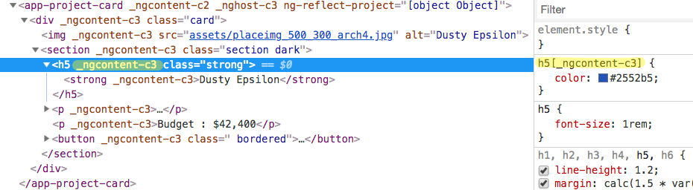
Component Styles Emulated View Encapsulation
Notes:
When using the default emulated view encapsulation, Angular preprocesses all component styles so that they approximate the standard Shadow CSS scoping rules.
When we inspect the DOM of a running Angular application with emulated view encapsulation enabled, we see that each DOM element has some extra attributes attached to it.
We see two kinds of generated attributes:
An element that would be a Shadow DOM host in native encapsulation has a generated _nghost attribute. This is typically the case for component host elements.
An element within a component's view has a _ngcontent attribute that identifies to which host's emulated Shadow DOM this element belongs. The exact values of these attributes are not important. They are automatically generated and we never refer to them in application code. But they are targeted by the generated component styles, which we'll find in the <head> section of the DOM. These are the styles we wrote, post-processed so that each selector is augmented with _nghost or _ngcontent attribute selectors. These extra selectors enable the scoping rules described in this guide. We'll likely live with emulated mode until shadow DOM gains traction.
Reference: https://angular.io/docs/ts/latest/guide/component-styles.html#!#view-encapsulation

Slide 140
Demo: Input Property
Instructor Only Demonstration
code\demos\component-styles

Slide 141
Labs
Lab 8: Formatting Data for Display
Lab 9: More Reusable Components
Lab 10: Responding to an Event
Lab 11: Create a Form to Edit Your Data
Lab 12: Communicating from Child to Parent Component
Attendees Hands-On Together

Slide 142
Directives
Built-In to Angular

Slide 143
CLIENT
Front-end
JavaScript in browser
NETWORK
(HTTP)
SERVER
Back-end
Web/Application server
Angular
Component
Component
Component
Component
Templates
<div>
{{ template}}
</div>
Architecture Diagram: Templates

Slide 144
What is a Directive?
Angular transforms the DOM according to the instructions given by directives
A directive is a class with directive metadata.
In TypeScript, we apply the @Directive decorator to attach metadata to the class
Notes:
Angular templates are dynamic. When Angular renders them, it transforms the DOM according to the instructions given by directives.
A directive is a class with directive metadata. In TypeScript, we apply the @Directive decorator to attach metadata to the class.
Reference:
https://angular.io/docs/ts/latest/guide/architecture.html#!#directives
Image from angular.io

Slide 145
Kinds of Directives
Component
A component is a directive-with-a-template
Structural
Structural directives alter layout by adding, removing, and replacing elements in DOM
Attribute
Attribute directives alter the appearance or behavior of an existing element
Notes:
Component:
We already met one form of directive: the component. @Component decorator is actually a @Directive decorator extended with template-oriented features.
Structural and Attribute directives tend to appear within an element tag as attributes do, sometimes by name but more often as the target of an assignment or a binding.
Structural:
*ngFor tells Angular to stamp out one <li> per item in a list.
*ngIf includes component only if a selected object exists or is truthy.
Attribute:
Attribute directives in templates look like regular HTML attributes, hence the name.
The ngModel directive, which implements two-way data binding, is an example of an attribute directive. ngModel modifies the behavior of an existing element (typically an <input>) by setting its display value property and responding to change events.
ngClass and ngStyle are a few of the handeful of other attribute directives
Reference:
https://angular.io/docs/ts/latest/guide/architecture.html#!#directives

Slide 146
Structural Directives
Structural directives alter layout by adding, removing, and replacing elements in DOM
ngIf
ngFor
ngSwitch

Slide 147
ngIf
Takes a boolean and makes an entire chunk of DOM appear or disappear
<p *ngIf="condition"> condition is true and ngIf is true. </p>
<p *ngIf="!condition"> condition is false and ngIf is false. </p>
Notes:
The ngIf directive does not hide the element. Using browser developer tools we can see that, when the condition is true, the top paragraph is in the DOM and the bottom disused paragraph is completely absent from the DOM!

Slide 148
Demo: ngIf
Instructor Only Demonstration
code\demos\ngIf

Slide 149
Labs
Lab 13: Hiding and Showing Components
Lab 14: Preventing a Page Refresh
Lab 15: More Component Communication (optional, do only if you are finishing labs early and want extra practice, similar to Lab 12)
Attendees Hands-On Together

Slide 150
Remove or Hide ngIf or hidden
<p *ngIf="condition"> Element to be added or removed </p> <button class="btn btn-warning" (click)="toggleIf()" >add | remove</button>
<p [hidden]=”!isVisible" > Element to show or hide using CSS </p> <button class="btn btn-warning"(click)="toggleVisibility()"> show | hide
</button>
Notes:
The can also hide an element using:
<p [style.display]="isVisible ? 'block':'none'" >
One uses CSS to hide the other uses a native DOM property they are both hiding the element so have similar performance trade-offs when compared to ngIf.

Slide 151
Hide or Remove hidden or ngIf
Hide: using [hidden]
Remove: using ngIf
The component's behavior continues
Remains attached to its DOM element
Continues to listen to events
Angular keeps checking for changes that could affect data bindings
The component — and all of its descendent components — tie up resources
Performance and memory burden can be substantial
Showing again is quick
The component's behavior stops
DOM element is removed
Stops listening to events
Angular stops checking for changes in data bindings
The component — and all of its descendent components — are cleaned up
Performance and memory burden are signifantly reduced
Showing again can be slow

Slide 152
Remove or Hide Heuristic hidden or ngIf
In general, it is best to use ngIf to remove unwanted components rather than hide them
The more complicated the element is, the more likely this will be the right choice

Slide 153
Understand How Structural Directives Work
<!-- Examples (A) and (B) are the same -->
<!-- (A) *ngIf paragraph --> <p *ngIf="condition"> Our heroes are true! </p> <!-- (B) [ngIf] with template --> <ng-template [ngIf]="condition"> <p> Our heroes are true! </p> </ng-template>
Notes:
The asterisk is "syntactic sugar". It simplifies ngIf and ngFor for both the writer and the reader. Under the hood, Angular replaces the asterisk version with a more verbose <ng-template> form.
Most of us would rather write in style (A).
It's worth knowing that Angular expands style (A) into style (B). It moves the paragraph and its contents inside a<template> tag. It moves the directive up to the <template> tag where it becomes a property binding, surrounded in square brackets. The boolean value of the host component's condition property determines whether the templated content is displayed or not.

Slide 154
NgSwitch
@Component({ selector: 'my-app', template: ` <div class="container"> <button (click)="value=1">select - 1</button> <button (click)="value=2">select - 2</button> <button (click)="value=3">select - 3</button> <h5>You selected : {{value}}</h5> <hr> <div [ngSwitch]="value"> <div *ngSwitchCase="1">1. Template - <b>{{value}}</b> </div> <div *ngSwitchCase="2">2. Template - <b>{{value}}</b> </div> <div *ngSwitchCase="3">3. Template - <b>{{value}}</b> </div> <div *ngSwitchDefault>Default Template</div> </div> </div> `, }) export class AppComponent {
value: number;
}
Notes:
See demos/ngswitch.
Reference:
https://angular.io/docs/ts/latest/api/common/index/NgSwitch-directive.html
http://plnkr.co/edit/ipzEQZnRrJqSui51hg8A?p=options

Slide 155
Demo: ngSwitch
Instructor Only Demonstration
code\demos\ngSwitch

Slide 156
Forms
Reactive Forms
Notes:
In this section, we will learn how to use model-driven or reactive forms.

Slide 157
Benefits of Forms
Forms are the mainstay of business applications
Login
Place an Order
Book a Flight
Schedule a Meeting

Slide 158
Form Strategies
Template-driven
Model-driven (new)
AngularJS style
FormsModule
Use the core ng prefix
Declarative in the template
Reactive programming
ReactiveFormsModule
Use the form prefix
Configured in component code
Enables dynamic forms
Facilitates unit testing
Notes:
In this section, we will focus on the model-driven form strategy.

Slide 159
Import Module projects.module.ts
@NgModule({
imports: [
CommonModule,
ProjectsRoutingModule,
ReactiveFormsModule,
SharedModule
],
declarations: [...]
})
export class ProjectsModule {}
Notes:
To start using reactive forms you need to import the ReactiveFormsModule into one of your application’s modules.
If you are not using template-driven forms you can also remove the reference to the FormsModule.

Slide 160
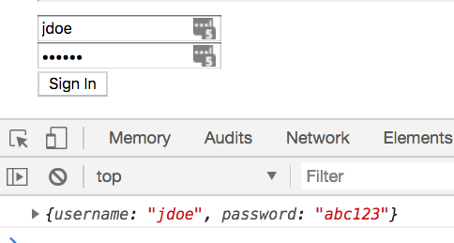
Demo: Reactive Forms Binding
Instructor Only Demonstration
code\demos\reactive-forms-binding

Slide 161
Labs
Lab 16: Forms | Binding

Slide 162
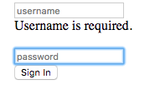
Demo: Reactive Forms Validation
Instructor Only Demonstration
code\demos\reactive-forms-validation

Slide 163
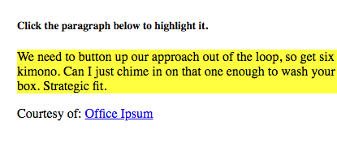
Demo: ngClass
Dynamically adds or removes CSS classes.
Instructor Only Demonstration
code\demos\ngClass

Slide 164
Labs
Lab 16: Forms | Binding
Lab 17: Forms | Saving
Lab 18: Forms | Validation
Attendees Hands-On
Lab 19: Forms | Refactor (Instructor Walkthrough)

Slide 165
Services
Angular

Slide 166
CLIENT
Front-end
JavaScript in browser
NETWORK
(HTTP)
SERVER
Back-end
Web/Application server
Angular
Component
Component
Component
Component
Service
Model
Model
Model
Templates
<div>
{{ template}}
</div>
Architecture Diagram: Services

Slide 167
What is a Service?
Service is a broad category, almost anything can be a service
A service is typically a class with a narrow, well-defined purpose
It should do something specific and do it well
Notes:
Reference:
https://angular.io/guide/architecture-services

Slide 168
Service Compared to Component
By separating a component's view-related functionality from other kinds of processing, you can make your component classes lean and efficient.
Ideally, a component's job is to enable the user experience and nothing more.
A component can delegate certain tasks to services, such as fetching data from the server, validating user input, or logging directly to the console. By defining such processing tasks in an injectable service class, you make those tasks available to any component.
Notes:
Reference:
https://angular.io/guide/architecture-services

Slide 169
Data Service project.service.ts
import { Injectable } from '@angular/core';
import { Observable, of } from 'rxjs';
import { Project } from './project.model';
import { PROJECTS } from './mock-projects';
@Injectable({
providedIn: 'root'
})
export class ProjectService {
constructor() { }
list(): Observable<Project[]> {
return of(PROJECTS);
}
}
Provides this service in the root module’s injector.
We cover dependency injection and injectors in the next section.
The RxJS of method creates an Observable which (like a Promise) allows us to easily work with Asynchronous operations like AJAX calls

Slide 170
Using a Data Service in a Component projects-conainter.component.ts
OnInit is an interface that has one method ngOnInit which is a component lifecyle event
export class ProjectsContainerComponent implements OnInit {
projects: Project[] = PROJECTS;
constructor(private projectService: ProjectService) {}
ngOnInit() {
this.projectService.list()
.subscribe(data => {
this.projects = data;
});
}
}
Tell Angular you need an instance of the service and the framework will Inject it into the constructor.
The list method returns an RxJS Observable.
We subscribe to the Observable and when it has data it will call the arrow function we passed as an argument.
Notes:
Reference: https://stackoverflow.com/questions/35763730/difference-between-constructor-and-ngoninit/35763811
ngOnChanges is called when an input or output binding value changes
ngOnInit is called after the first ngOnChanges
If initialization requires access to an input parameter then you need to use ngOnOnit.

Slide 171
Demo: Services
Instructor Only Demonstration
code\demos\services

Slide 172
Labs
Lab 20: Services
Attendees Hands-On

Slide 173
Dependency Injection
Angular

Slide 174
Dependency Injection explained
Imagine you are not allowed to use the new keyword and create instances of other objects (dependencies) you need when writing code
Dependency Injection is a practice where objects are designed in a manner where they receive instances of the objects from other pieces of code, instead of constructing them internally
This means that any object implementing the interface which is required by the object can be substituted in without changing the code, which simplifies testing, and improves decoupling
Notes:
Reference: https://stackoverflow.com/questions/130794/what-is-dependency-injection

Slide 175
Dependency Injection example
//no DI class CustomersComponent{ private customerService = new CustomerDataAccessService (); }
//using DI class CustomersComponent{ private customerService : CustomerDataAccessService; constructor(customerService : CustomerDataAccessService){ this.customerService = customerService; } }
Notes:
The top example gets the objects it depends on (dependencies) by calling using the new keyword and instantiating it.
How might you replace the implementation of the customService inside the CustomersComponent?
The bottom example injects its dependencies in the constructor so it is possible to change its implementation without changing code in the CustomersComponent.

Slide 176
Dependency Injection Frameworks
Java
Spring, Guice
.NET
Ninject, Structure Map, Unity, Spring.NET, .NET Core (built-in)
Angular
Dependency Injection is built-in

Slide 177
Notes:
In AngularJS every injectable service was a singleton because there was only one injector in the framework to look up dependencies.
In Angular there is a separate injector created for each module and component.
Registering services in Angular modules puts them in the root injector*
Registering services in a component makes them available to that component and any of its child components
*unless the module is lazy-loaded in a feature in which case they are placed in the feature module’s injector

Slide 178
Providing Services in the Root Module Injector project.service.ts
import { Injectable } from '@angular/core'; import { Observable, of } from 'rxjs'; import { Project } from './project.model'; import { PROJECTS } from './mock-projects'; @Injectable({ providedIn: 'root' }) export class ProjectService { list(): Observable<Project[]> { return of(PROJECTS); } }
Provides this service in the root injector (Singleton)
RxJS of method creates an Observable
Notes:
Equivalent of angular.module(‘app’).service(‘ProjectService’) in AngularJS.
It is a best practice to add an @Injectable annotation to all services. We will talk about @Injectable in detail in the advanced DI section.
We will talk about observables, for now just know that it’s preparing us to make AJAX calls with the same code later in the course.

Slide 179
Providing Services in a Feature Module Injector project.service.ts
import { Injectable } from '@angular/core'; import { Observable, of } from 'rxjs'; import { Project } from './project.model'; import { PROJECTS } from './mock-projects'; @Injectable({ providedIn: ProjectsModule }) export class ProjectService { list(): Observable<Project[]> { return of(PROJECTS); } }
Provides this service in the ProjectsModule injector

Slide 180
Service Registration Best Practices
Provide services in the Service itself (providedIn)
Set providedIn to
root if you want the service to be a Singleton
Feature Module (ProjectsModule) if you want the service to be lazy-loaded
Lazy Loading requires additional steps which are covered in the Routing section of the course

Slide 181
Http
Angular
Notes:
HTTP is the primary protocol for browser/server communication.
The WebSocket protocol is another important communication technology that will be used more in the future.

Slide 182
CLIENT
Front-end
JavaScript in browser
NETWORK
(HTTP)
SERVER
Back-end
Web/Application server
Angular
Java
.NET
Node.js
Python
Go
Oracle
MySQL
SQL Server
PostgreSQL
MongoDB
Component
Component
Component
Component
Service
Web API
DB
Model
Model
Model
Templates
<div>
{{ template}}
</div>
Architecture Diagram: HTTP

Slide 183
Labs
Lab 21: Setup Backend REST API (attendees with instructor)
Rest Review (instructor only demonstration) (optional)
Notes:
See lab manual.

Slide 184
HttpClient Overview
Import HttpClientModule
HttpClient in Services
Observables in Components

Slide 185
Import HttpClientModule
import { HttpClientModule } from '@angular/common/http';
@NgModule({
declarations: [AppComponent],
imports: [BrowserModule, AppRoutingModule,
ProjectsModule, HttpClientModule],
providers: [],
bootstrap: [AppComponent]
})
export class AppModule {}

Slide 186
HttpClient in Services
import { HttpClient } from '@angular/common/http';
import { environment } from '../../../environments/environment';
...
export class ProjectService {
private projectsUrl = environment.backendUrl + '/projects/';
constructor(private http: HttpClient) {}
list(): Observable<Project[]> {
return this.http.get<Project[]>(this.projectsUrl);
}
}

Slide 187
Observables in Components
...
export class ProjectsContainerComponent implements OnInit {
projects: Project[];
errorMessage: string;
constructor(private projectService: ProjectService) {}
ngOnInit() {
this.projectService.list().subscribe(
data => {
this.projects = data;
}
);
}
...
}

Slide 188
Labs
Lab 22: HTTP GET
Notes:
See lab manual.

Slide 189
Demos: Http Get
Instructor Only Demonstration
code\demos\http-get

Slide 190
Error Handling in Services
import { Observable, of, throwError } from 'rxjs';
import { catchError } from 'rxjs/operators';
import { HttpClient, HttpErrorResponse } from '@angular/common/http';
...
export class ProjectService {
...
list(): Observable<Project[]> {
return this.http.get<Project[]>(this.projectsUrl).pipe(
catchError((error: HttpErrorResponse) => {
console.log(error);
return throwError('An error occurred loading the projects.');
})
);
}
}

Slide 191
Error Handling in Components
...
export class ProjectsContainerComponent implements OnInit {
projects: Project[];
errorMessage: string;
constructor(private projectService: ProjectService) {}
ngOnInit() {
this.projectService.list().subscribe(
data => {
this.projects = data;
},
error => {
this.errorMessage = error;
}
);
}
...
}

Slide 192
Demos: Http Error Handling
Instructor Only Demonstration
code\demos\http-error-handling

Slide 193
Labs
Lab 23: HTTP Error Handling
Notes:
See lab manual.

Slide 194
HttpClient PUT
...
import { HttpClient, HttpErrorResponse, HttpHeaders } from '@angular/common/http';
const httpOptions = {
headers: new HttpHeaders({ 'Content-Type': 'application/json' })
};
export class ProjectService {
...
put(project: Project): Observable<Project> {
const url = this.projectsUrl + project.id;
return this.http.put<Project>(url, project, httpOptions).pipe(
catchError((error: HttpErrorResponse) => {
console.log(error);
return throwError('An error occurred updating the projects.');
})
);
}
}
Notes:
Now lets look at saving data.
We start by adding a put method to the ProjectService.
Notice that since we are posting a serialized JS object (JSON) we need to tell the server that we are sending JSON in the headers by adding a Content-Type set to application/json.

Slide 195
Labs
Lab 24: HTTP PUT
Lab 25: Showing a Loading Indicator (optional)
Notes:
See lab manual.

Slide 196
Routing & Navigation
Angular

Slide 197
CLIENT
Front-end
JavaScript in browser
NETWORK
(HTTP)
SERVER
Back-end
Web/Application server
Angular
Java
.NET
Node.js
Python
Go
Vert.x
Oracle
MySQL
SQL Server
PostgreSQL
MongoDB
Component
Component
Component
Route
Router
Component
Service
Web API
DB
Route
Model
..
<router-outlet>
</router-outlet>
Model
Model
Templates
<div>
{{ dynamic}}
</div>
app.component.html
<app-root>
</app-root>
Architecture Diagram
index.html
Notes:
UI/Web components are the center of the Angular universe.
These web components are code (component) and html (template).
The html includes Angular and application specific html extensions known as directives.
The template (html) is compiled into JavaScript and combined with the component code.
Angular’s main purpose is take easily understandable, maintainable TypeScript component code and the HTML template and combine it into efficient browser executable JavaScript responsible for rendering part of a web page.
Services used to communicate with a back-end server (commonly via HTTP, AJAX)
Web APIs are implemented in a variety of different technologies.
Router allows you to associate a URL with a particular component(s) and its child components.

Slide 198
Router Overview
A router watches the browser’s url for changes and runs the corresponding code for that url (route).
JavaScript applications commonly break the back button in the browser. A router can fix this problem.
Before HTML5 there was no way to write to the browser’s history via JavaScript
The HTML5 history API (also know as pushState/replaceState) enables JavaScript code to add or modify history entries
Before HTML5 history, JavaScript applications used the fragment identifier introduced by a hash mark # and is the optional last part of a URL for a document. It is typically used to identify a portion of that document (hyperlink bookmarks).

Slide 199
Notes:
Ruby on Rails, Spring(Java), Larvel (PHP), ASP.NET (Microsoft)
Where does the html and the data come together?
In this case, it’s the server (web server).

Slide 200
Component Router Angular
Navigates you through components and their corresponding client-side views without a page reload
Bind the router to links on a page and it navigates to the appropriate application view when they are clicked
Also can navigate imperatively when the user clicks a button, selects from a drop box, or in response to some other stimulus
Logs activity in the browser’s history journal so the back and forward buttons work as expected
Notes:
The Angular router borrows from the traditional browser navigation model except it enables us to do it in the client/browser using JavaScript.
Reference:
https://angular.io/docs/ts/latest/guide/router.html

Slide 201
Notes:
Client-side or Single-page web application architecture (Angular, Backbone, React, Ember)
Initial HTTP request for single-page (shell page, often index.html)
AJAX requests for partial page HTML templates
The templates are filled in with data from AJAX requests to a web API (frequently serving JSON)
The resulting markup is then filled in to the placeholder on the shell page
The Angular component model enables this architecture as part of the framework.

Slide 202
Routing Summary
The application is provided with a configured router.
The component has a RouterOutlet where it can display views produced by the router.
It has RouterLinks that users can click to navigate via the router.
Notes:
Reference:
https://angular.io/docs/ts/latest/guide/router.html

Slide 203
Router Configuration
import { NgModule } from '@angular/core';
import { Routes, RouterModule } from '@angular/router';
import { HomeComponent } from './home/home.component.ts'
const routes: Routes = [
{ path: 'home', component: HomeComponent }
];
@NgModule({
imports: [RouterModule.forRoot(routes)],
exports: [RouterModule]
})
export class AppRoutingModule { }
Create an array of Route objects.
Configure the routes in the app.
Create a RouterModule configured with the application routes.
The Angular CLI generates all this code except the Route objects.
We will learn more about modules next.

Slide 204
Router Outlet
<div class="container">
<router-outlet>
</router-outlet>
</div>
Placeholder where the component configured in the Route object gets rendered

Slide 205
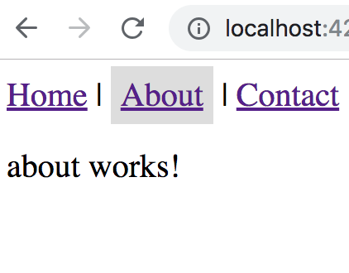
Demo: Routing Basics
Instructor Only Demonstration
code\demos\routing-basics

Slide 206
Labs
Lab 26: Router Navigation
Notes:
See lab manual.

Slide 207
Navigating
Using a routerLink directive
Route parameters
Query parameters
Navigating with Code
Router
Route parameters
Query parameters
Retrieving Parameters
ActivatedRoute
Synchronous
Asynchronous

Slide 208
Route Parameters or Query Parameters?
There is no hard-and-fast rule. In general,
prefer a route parameter when
the value is required.
the value is necessary to distinguish one route path from another.
prefer a query parameter when
the value is optional.
the value is complex and/or multi-variate.
Notes:
Reference:
https://angular.io/docs/ts/latest/guide/router.html#!#query-parameters

Slide 209
Matrix URL Notation
The query string parameters are not separated by "?" and "&". They are separated by semicolons (;)
This is matrix URL notation — something we may not have seen before.
Matrix URL notation is an idea first floated in a 1996 proposal by the founder of the web, Tim Berners-Lee.
Notes:
Although matrix notation never made it into the HTML standard, it is legal and it became popular among browser routing systems as a way to isolate parameters belonging to parent and child routes. The Angular Component Router is such a system.
The syntax may seem strange to us but users are unlikely to notice or care as long as the URL can be emailed and pasted into a browser address bar as this one can.
Reference:
https://angular.io/docs/ts/latest/guide/router.html#!#query-parameters

Slide 210
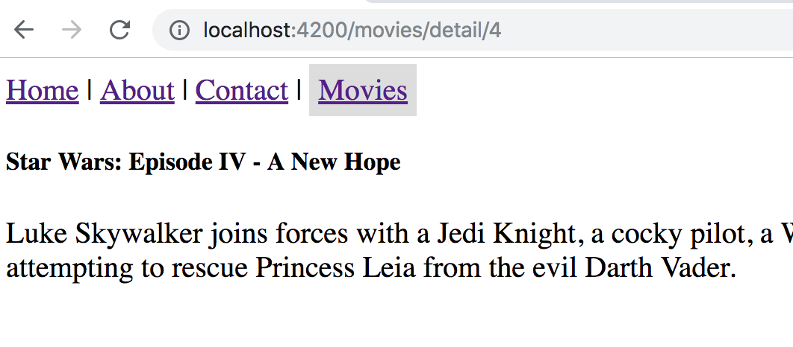
Demo: Routing Navigation
Instructor Only Demonstration
code\demos\routing-navigation

Slide 211
Labs
Lab 27: Router Parameters
Notes:
See lab manual.

Slide 212
Build & Deploy
Using Angular CLI (Command-Line Interface)
Notes:
In this section, we will learn about the Angular CLI or Command-line Interface.
Reference: https://cli.angular.io/

Slide 213
Angular CLI: Builds
Builds your application for deployment to production
Combining, minifying
Tree-shaking
Ahead-of-time compilation
Remove Decorators
Notes:
First 3 bullet points are really helpful but the last 3 are where the CLI will really save you time.
Creating your own build process with Webpack can consume weeks of development time.
Reference: https://github.com/angular/angular-cli/wiki

Slide 214
CLI: Builds
The build command sends output to the dist directory.
Copy the contents of the dist directory to your web server to deploy.
Run a development build
ng build --dev
Note: running just “ng build” defaults to a ”dev” build
Run a production build
ng build --prod
Passing the dev or prod flags effectively sets other flags
These flags are “meta” flags
Notes:
Combines &minifies the code
Utilizes webpack tree-shaking
Does Ahead-of-time (AOT) compilation
AOT compiles the templates into js on the server instead of the browser
Over 50% of Angular framework (the client template engine) does not need be sent to the browser.

Slide 215
Demo
Angular CLI: Builds
Instructor

Slide 216
Dev vs Prod Builds
Flag | --dev | --prod
--aot | false | true
--environment | dev | prod
--output-hashing | media | all
--sourcemaps | true | false
--extract-css | false | true
--named-chunks | true | false
--build-optimizer | false | true with AOT and Angular 5
Notes:
Reference: https://github.com/angular/angular-cli/wiki/build#--dev-vs---prod-builds
--prod also sets the following non-flaggable settings:
Adds service worker if configured in .angular-cli.json.
Replaces process.env.NODE_ENV in modules with the production value (this is needed for some libraries, like react).
Runs UglifyJS on the code.

Slide 217
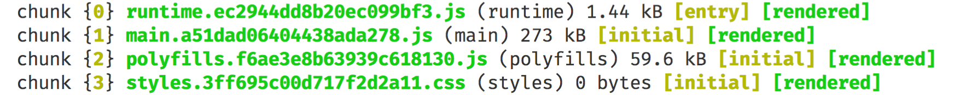
Bundles
runtime.bundle.js is webpack
polyfills.bundle.js includes core-js and zone.js
styles.bundle.js | .css includes all the CSS component styles as well as global styles in styles.css combined into one file
vendor.bundle.js includes all the all the angular framework and rxjs
when using build optimizer the vendor bundle is combined into the main bundle
main.bundle.js includes all your application code
Notes:
Reference:
https://github.com/preboot/angular2-webpack/issues/287

Slide 218
Bundle Sizes
 | dev (kB) | prod (kB)
runtime.bundle.js | 5.83 | 1.45
main.bundle.js | 27.90 | 239.00
polyfills.bundle.js | 202.00 | 61.30
styles.bundle.js | css * | 11.40 | 0.08
vendor.bundle.js | 2,730.00 | **
total | 2,977.13 | 301.83
* Styles produce js file in dev mode but a css file in prod.

Slide 219
Ahead-of-Time (AOT) Compiler
Angular offers two ways to compile your application:
Just-in-Time (JIT), which compiles your app in the browser at runtime
Ahead-of-Time (AOT), which compiles your app at build time.
Converts your Angular HTML and TypeScript code into efficient JavaScript code during the build phase before the browser downloads and runs that code.
The size of the Angular framework downloaded in the browser decreases in size by over 50%. Angular’s template compiler code does not need to be sent to the browser because the template compilation has been done ahead-of-time.

Slide 220
Build Optimizer
Build-Optimizer (PurifyPlugin) is a Webpack plugin created by the Angular team, specifically to optimize Webpack builds beyond what Webpack can do on its own.
Optimizations
Removal of Angular decorators from AoT builds
adding /*@__PURE__*/ annotations to transpiled/downleveled TypeScript classes. The point of this is to make it easier for minfiers like Uglify to remove unused code.
Full list of optimizations is available here:
https://www.npmjs.com/package/@angular-devkit/build-optimizer
Notes:
Reference:
http://www.syntaxsuccess.com/viewarticle/angular-build-optimizer

Slide 221
Build Optimizer and Vendor Chunk
When using Build Optimizer the vendor chunk will be disabled by default. You can override this with --vendor-chunk=true.
Total bundle sizes with Build Optimizer are smaller if there is no separate vendor chunk because having vendor code in the same chunk as app code makes it possible for Uglify to remove more unused code.
Notes:
Reference: https://github.com/angular/angular-cli/wiki/build#--build-optimizer-and---vendor-chunk

Slide 222
Labs
Lab 29: Build & Deploy
Notes:
See lab manual.

Slide 223
Appendices
The remainder of the topics in this manual are not always able to be covered during the introductory course. Instructors can choose to include them as time allows or questions arise. Students can use them as additional information to go deeper on topics particularly around the setup, build, and deployment of an Angular project.

Slide 224
Custom Pipe Example
import {Pipe, PipeTransform} from '@angular/core'; @Pipe({ name: 'charlength' }) export class CharacterLengthPipe implements PipeTransform{ transform(value:string, length:number){ return value.substring(0, length); } }
Notes:
To create a custom pipe you need to:
Import the Pipe class from Angular’s core package
Export a class annotated with the Pipe attribute.
Give the pipe a name in the annotation which is how you will refer to it in a template.
By convention Pipe classes usually have a Pipe suffix.

Slide 225
Labs
Lab 28: Custom Pipe
Notes:
See lab manual.

Slide 226
Past, Present & Future
Features in Different Angular Versions
Notes:
In this section, we will learn about the Angular CLI or Command-line Interface.
Reference: https://cli.angular.io/

Slide 227
Angular 4
Released 2017-03-23 (code named invisible-makeover)
View Engine generates smaller code
Enhanced *ngIf syntax
Animation code now in own packages
TypeScript 2.1
Improved compiler speed
Compliant with StrictNullChecks
Universal
Run your Angular code on a server, not just browser
Faster initial render
Search Engine Optimization benefits for public sites
Flat ESModules
More efficient tree shaking
HttpClient (introduced in 4.3)
Notes:
Changing from version 2 to version 4, 5, … won’t be like changing from AngularJS. It won’t be a complete rewrite, it will simply be a change in some core libraries that demand a major SEMVER version change. Also, there will be proper deprecation phases to allow developers to adjust their code.
Reference: http://angularjs.blogspot.com/2016/12/ok-let-me-explain-its-going-to-be.html

Slide 228
Angular 5
Released 2017-11-01 (code named pentagonal-donut)
Performance (Angular CLI v1.5)
Build optimizer
Webpack Plugin: require('@angular-devkit/build-optimizer').PurifyPlugin;
Additional optimizations (better tree shaking)
Angular Compiler
Faster builds and rebuilds, uses TypeScript transforms
Intl and Reflect polyfills no longer needed
Can configure (ts.config) preserveWhitespaces: false in template
Features
upDateOn blur or submit
Router new lifecycle events
Package to faciliate adding service worker to apps (Progressive Web Apps)
Upgrade tool
https://angular-update-guide.firebaseapp.com/
Notes:
References:
https://blog.angular.io/version-5-0-0-of-angular-now-available-37e414935ced
https://alligator.io/angular/angular-5/
Service Worker:
Service workers essentially act as proxy servers that sit between web applications, and the browser and the network (when available). They are intended to (amongst other things) enable the creation of effective offline experiences, intercepting network requests, and taking appropriate action based on whether the network is available, and updated assets reside on the server. They will also allow access to push notifications and background sync APIs.
Reference:
https://developer.mozilla.org/en-US/docs/Web/API/Service_Worker_API

Slide 229
Angular 6
Released May 3rd
Aligning library releases (version numbers)
Angular Elements
Extending Angular CLI with Schematics
RxJS 6 imports
Service Providers
Instead of a module referencing services
Services reference modules
Notes:
References:
https://blog.angular.io/version-6-of-angular-now-available-cc56b0efa7a4
https://g.co/ng/2018-keynote-1

Slide 230
Aligning Library Releases
 | Today | With v6
Angular | 5.2.10 | 6.0
Material | 5.2.4 | 6.0
CLI | 1.7 | 6.0
Notes:
Reference: Ng-conf Day 1 Keynote 2018

Slide 231
Angular Elements
Wrap Angular Component as a
Custom Element (aka DOM Element)

Slide 232
Angular Elements: How it Works
You
They
Write components
Wrap as Custom Element
Import script
Use component

Slide 233
Use Cases
Use Angular component in another Angular app
Use Angular components with other libraries/frameworks
Like a simple jQuery app or VueJS app
Use Anguar components in any app written with any technology

Slide 234
Extending Angular CLI with Schematics
ng [command]
new
generate
update
add
project
component
module
service
pipe
...

Slide 235
ng update
Update
Npm dependencies
Code
V6: RxJS, Material

Slide 236
ng add
Add capabilities
Instant code and library scaffolding
Supported by:
Angular Material (Ex. ng add @angular/material)
Angular Elements
Progressive Web App
Ng-bootstrap
Clarity
NativeScript
Also, per-library ’generate’ schematics

Slide 237
RxJS 5 Imports Non-Exhaustive List
rxjs rxjs/Rx rxjs/Observable rxjs/Subject rxjs/BehaviorSubject rxjs/ReplaySubject rxjs/observable/interval rxjs/observable/timer rxjs/observable/from rxjs/observable/of rxjs/observable/fromEvent rxjs/observable/defer rxjs/observable/if rxjs/observable/throw rxjs/observable/empty rxjs/observable/never rxjs/observable/using rxjs/observable/generate | rxjs/operators/audit rxjs/operators/auditTime rxjs/operators/buffer rxjs/operators/bufferCount rxjs/operators/bufferTime rxjs/operators/bufferToggle rxjs/operators/bufferWhen rxjs/operators/catch rxjs/operators/combineAll rxjs/operators/combineLatest rxjs/operators/concat rxjs/operators/concatAll rxjs/operators/concatMap rxjs/operators/concatMapTo rxjs/operators/count rxjs/operators/debounce rxjs/operators/debounceTime rxjs/operators/defaultIfEmpty | rxjs/operators/audit rxjs/operators/auditTime rxjs/operators/buffer rxjs/operators/bufferCount rxjs/operators/bufferTime rxjs/operators/bufferToggle rxjs/operators/bufferWhen rxjs/operators/catch rxjs/operators/combineAll rxjs/operators/combineLatest rxjs/operators/concat rxjs/operators/concatAll rxjs/operators/concatMap rxjs/operators/concatMapTo rxjs/operators/count rxjs/operators/debounce rxjs/operators/debounceTime rxjs/operators/defaultIfEmpty | There are a LOT
Notes:
Reference: Introducing RxJS 6 Slides- ngconf 2018
https://docs.google.com/presentation/d/1h-h4IUgh8mRqItF2F2Ih8g-H9gYjb8MCwHnoIVm-hiU/edit#slide=id.g389cbad6b8_1_203

Slide 238
RxJS 6 Imports
rxjs: Contains creation methods, types, schedulers, and utilities
import { Observable, Subject, pipe, of, from, interval, merge, fromEvent, } from 'rxjs';
rxjs/operators: Contains all pipeable operators
import { map, filter, scan } from 'rxjs/operators';

Slide 239
Upgrading to Angular 7
If already on Angular 6 and RxJS 6
ng update @angular/cli @angular/core
If using Angular Material also run
ng update @angular/material

Slide 240
Angular 7
Angular CLI prompts
Angular Material CDK
ScrollingModule\ Virtual Scroll Viewport
DragDropModule
Application Performance
Reflect-metadata polyfill not included in production builds
Angular CLI Budget Bundles
Updated Dependencies
TypeScript 3.1
RxJS 6.3
Node 10 support
Angular Elements now supports content projection using web standards (slots) for custom elements

Slide 241
Ivy
Next generation Angular Renderer
Backward compatible
No changes required for existing apps
Benefits
Faster
Improve the speed of rendering
Smaller
Optimizes the size of the final package
Simpler
Human-readable code
Easy debugging (stack trace heaven)
Notes:
Not production ready yet.
Can be turned on in Angular 6 with a compiler flag.

Slide 242
Slide from Ng-conf Day 1 Keynote 2018
Notes:
Reference: https://g.co/ng/2018-keynote-1

Slide 243
RxJS

Slide 244
RxJS
Reactive Extensions for JavaScript
RxJS is a library for composing asynchronous and event-based programs by using observable sequences.
It provides one core type, the Observable, satellite types (Observer, Schedulers, Subjects) and operators inspired by Array#extras(map, filter, reduce, every, etc) to allow handling asynchronous events as collections
Using RxJS, developers represent asynchronous data streams with Observables and query asynchronous data streams using the many operators (functions) provided

Slide 245
Observable
(data source)
subscribe( observer: Observer )
Subscription
Observer
next()
error()
complete()

Slide 246
Time
Observable
Observer
next()
error()
complete()

Slide 247
Observable
A representation of any set of values over any amount of time
The most basic building block of RxJS
Represents a data source that streams values over time
Observables are lazy push collections of multiple values
 | Single | Multiple
Pull | Function | Iterator
Push | Promise | Observable

Slide 248
Observable Creation Functions
Usually used to create Observables from scratch
Pure functions attached to the Observable class in RxJS <=5.4
Stand-alone functions in RxJS >=5.5 to RxJS<6
import { of } from 'rxjs/observable/of';
RxJS >=6
import { of } from 'rxjs';
Notes:
Reference: http://reactivex.io/rxjs/manual/overview.html#instance-operators-versus-static-operators

Slide 249
Time
Observable
X
Observer
next()
error()
complete()

Slide 250
Creating Observables
of(1,2,3)
.subscribe(x=> console.log(x)); // 1, 2, 3
from([1,2,3])
.subscribe(x=> console.log(x)); // 1, 2, 3
create(internalObserver => {
internalObserver.next('a');
internalObserver.next('b');
})
.subscribe(x => console.log(x)); //a, b

Slide 251
Creating Observables
let button = document.querySelector("button");
fromEvent(button, "click")
.subscribe(x => console.log(x));
let input = document.querySelector("input");
fromEvent(input, "keyup")
.subscribe((x: Event) => console.log(x.target.value));

Slide 252
Demo: Obervables
Instructor Only
code/demos/rxjs-observables

Slide 253
Observer
A collection of callbacks that knows how to listen to values delivered by the Observable
An Observer is a consumer of values delivered by an Observable
Observers are simply a set of callbacks, one for each type of notification delivered by the Observable:
next
error
complete

Slide 254
Observer Example
//Observer let observer: Observer<any> = { next: x => console.log(x), complete: () => console.log('completed'), error: x => console.log(x) }
of(1,2,3)
.subscribe(observer); // 1, 2, 3, completed

Slide 255
Demo: Observers
Instructor Only
code/demos/rxjs-observers
code/demos/rxjs-subscriptions

Slide 256
Operators
Methods on Observable instances in RxJS <=5.4
Stand-alone functions in RxJS >=5.5
import { map, filter } from 'rxjs/operators';
Use the this keyword to infer what is the input Observable
Notes:
Reference: http://reactivex.io/rxjs/manual/overview.html#instance-operators-versus-static-operators

Slide 257
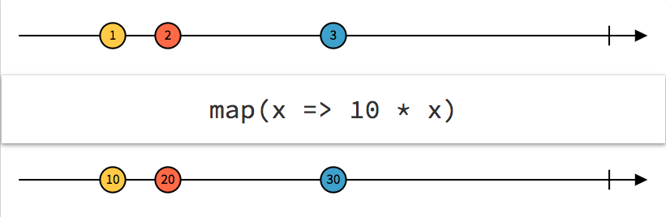
map Operator
//map returns same number of items as source of(1, 2, 3) .pipe(map(x => x * 10)) .subscribe(x => console.log(x)); //10, 20, 30
Source: rxmarbles.com

Slide 258
switchMap Operator
let obs1$ = of(1, 2, 3); let obs2$ = of('a', 'b'); obs1$.pipe(switchMap(() => obs2$)).subscribe(observer); // a, b, a, b, a, b, completed
let obs1$ = of(1, 2, 3); let obs2$ = of('a', 'b'); obs1$.pipe(switchMap(() => obs2$, (n, l) => n + l)).subscribe(observer); //1a, 1b, 2a, 2b, 3a, 3b

Slide 259
Demo: Operators
Instructor Only
code/demos/rxjs-operators

Slide 260
Subject
A Subject is like an Observable, but can multicast to many Observers
Subjects are like EventEmitters: they maintain a registry of many listeners
Plain Observables are unicast (each subscribed Observer owns an independent execution of the Observable)
Notes:
Reference: http://reactivex.io/rxjs/manual/overview.html#multicasted-observables

Slide 261
Subject Example
var subject = new Subject();
subject.subscribe({ next: (v) => console.log('observerA: ' + v) });
subject.subscribe({ next: (v) => console.log('observerB: ' + v) });
subject.next(1); subject.next(2);
// observerA: 1 // observerB: 1 // observerA: 2 // observerB: 2

Slide 262
Demo: Subjects
Instructor Only
code/demos/rxjs-subjects

Slide 263
Practical Application of RxJS
this.items = this.searchTermStream.pipe( debounceTime(300), distinctUntilChanged(), switchMap((term: string) => this.wikipediaService.search(term)) );
debounceTime waits for the user to stop typing for at least 300 milliseconds
distinctUntilChanged ensures that the service is called only when the new search term is different from the previous search term
switchMap calls the WikipediaService with a fresh, debounced search term and coordinates the stream(s) of service response

Slide 264
Demo: Practical Application of RxJS
Instructor Only
code/demos/rxjs-practical

Slide 265
EventEmitter or Observable
Summary
Use EventEmitter in Components
Use some form of an Observable (Observable, Subject, BehaviorSubject) in Services
Explanation
Do NOT count on EventEmitter continuing to be an Observable
Do NOT count on those Observable operators being there in the future
Only call event.emit()… Don't defeat angular's abstraction
Notes:
Reference: https://stackoverflow.com/questions/36076700/what-is-the-proper-use-of-an-eventemitter

Slide 266
Observables and Reactive Programming In Angular
We can structure our application to use Observables as the backbone of our data architecture
Using Observables to structure our data is called Reactive Programming
Reactive programming is programming with asynchronous data streams
Observables are the main data structure we use to implement Reactive Programming.
Notes:
Reference:
https://www.ng-book.com/2/

Slide 267
Promises vs. Observables
Promises
Observables
Returns single value
Not cancellable
Standard as of ES 2015
Returns multiple values over time
Cancellable
Retry
Supports map, filter, reduce and similar operators
Proposed feature for ES 2016
Angular uses Reactive Extensions (RxJS)

